Slide 1
Robotics Project
CS: 104 04
Awn Rizvi, Christian Ramos, Jaden Rodriguez

Slide 2
Challenges
Meeting times and time management.
Conflicting schedules.
Production of various codes.
Correctly aiming/angling robot to accurately cross through course.

Slide 3
Roles
Christian Ramos-Coder, Tester.
Code to ensure robot completes course, as well as testing these codes.
Awn Rizvi- Document Manager.
Drafted charts and completed design documents.
Jaden Rodriguez- Project Manager.
Plan meetings and ensure role conductivity.

Slide 4
What We’ve Learned
Developing and fully seeing through a software project takes tedious planning involving many preordained plans before coding can even start.
Importance of time management.
Overall basic concept of the methodologies of software development, from flowcharting to testing.

Slide 5
What We Would Change
Punctuality
Additional meeting times planned around convenience of various schedules.
Accomodation for group members that have inaccessibility to computer or lab times.

Slide 6
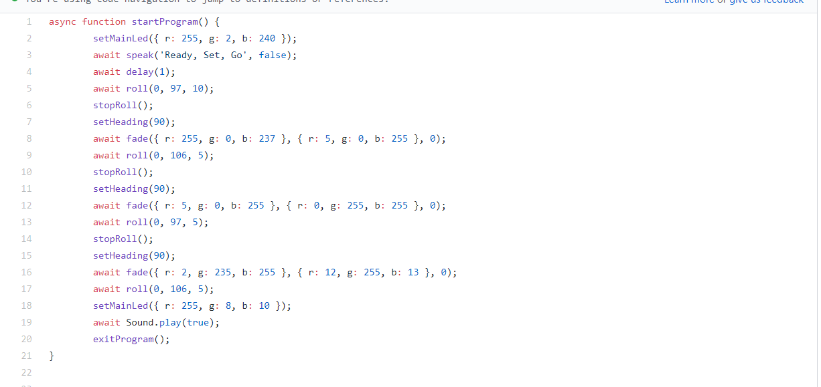
Sprint 1 Code Endurance

Slide 7
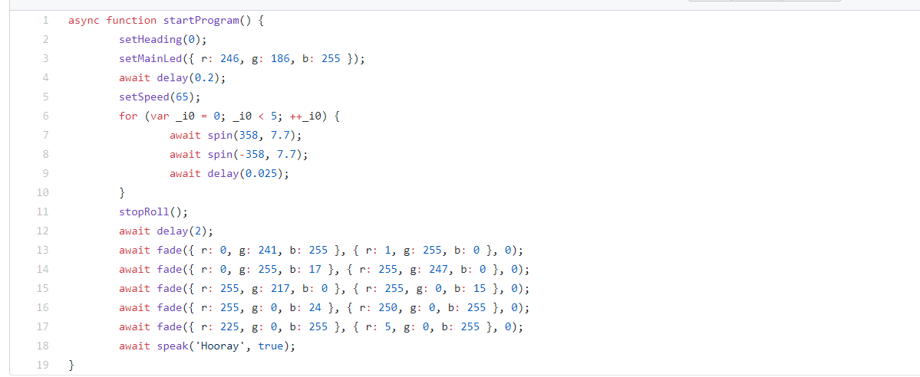
Sprint 2 Code Speed

Slide 8
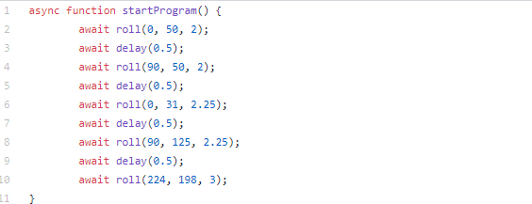
Sprint 3 Code Agility

